Slide 1


Snapshot of inequality and poverty in Australia
Dr Cassandra Goldie, CEO ACOSS
Community Tax Summit, Melbourne 20-21 February

Slide 2
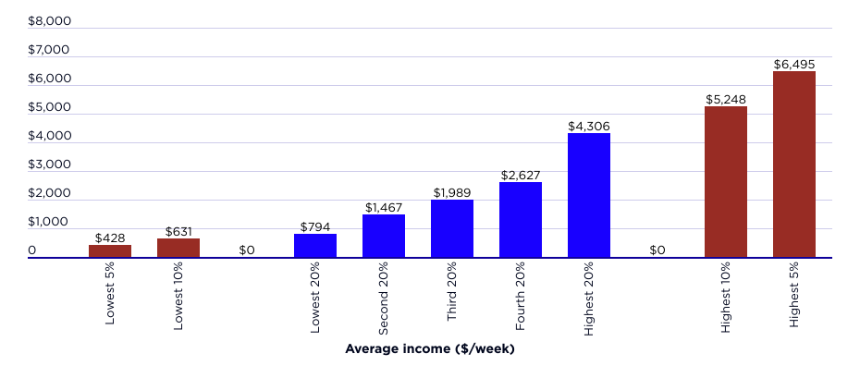


The highest 5% of households gets $6,500pw after tax
on average, eight times the lowest 20%
Average weekly after-tax income by household income group in 2019

Slide 3
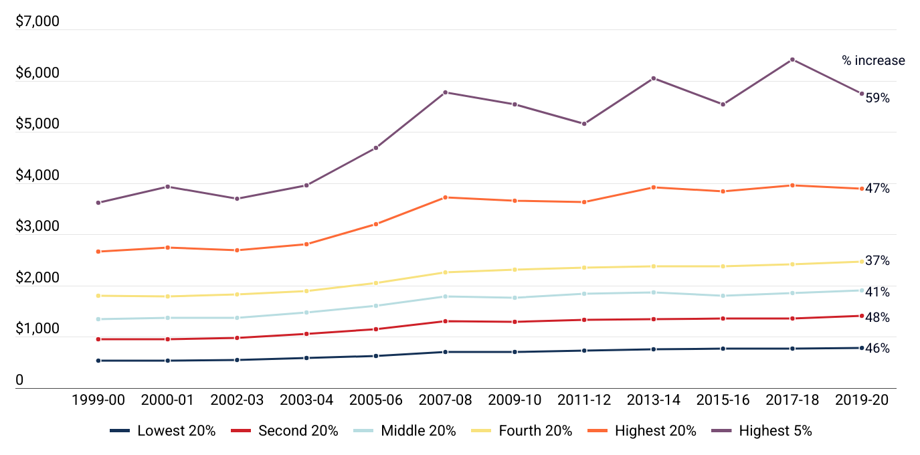
The income of the highest 5% of households grew by 59% since 1999, compared with 46% for the lowest 20%
Trends in real average weekly after-tax income from 1999 to 2019 (in 2019 dollars)

Slide 4
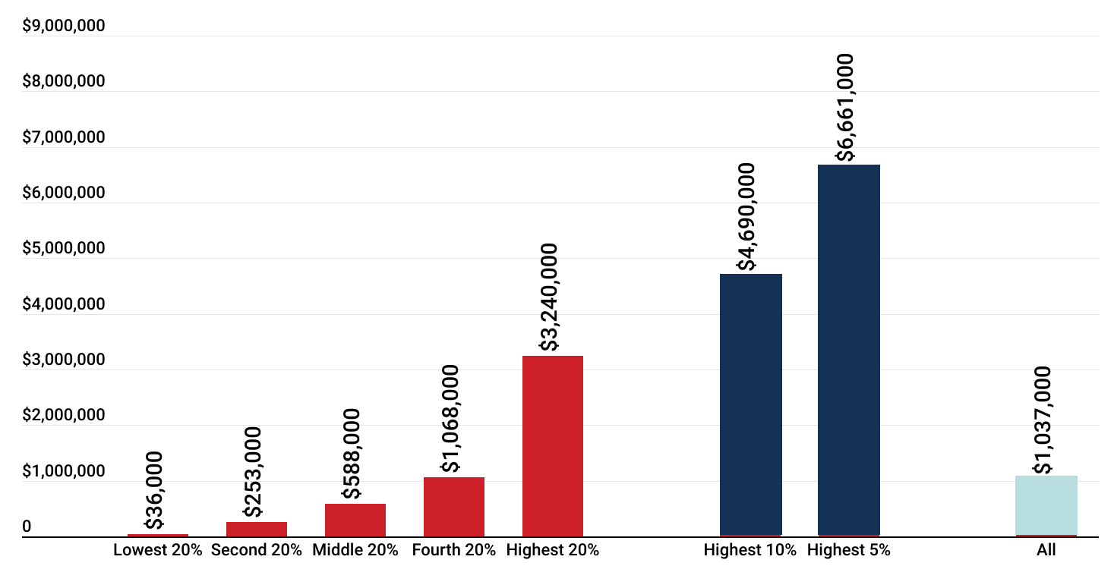
The average wealth of the highest 5% of households is $6.7M, 185 times the lowest 20%
Average household net wealth by wealth group ($000 in 2019-20)

Slide 5
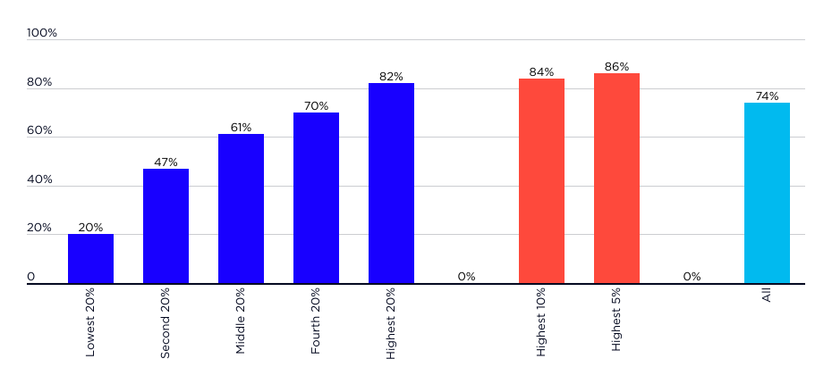
The wealth of the highest 5% grew by 86% since 2003,
four times faster than the lowest 20%
Increase in average real wealth by wealth group, 2003-04 to 2022-23 (%)

Slide 6
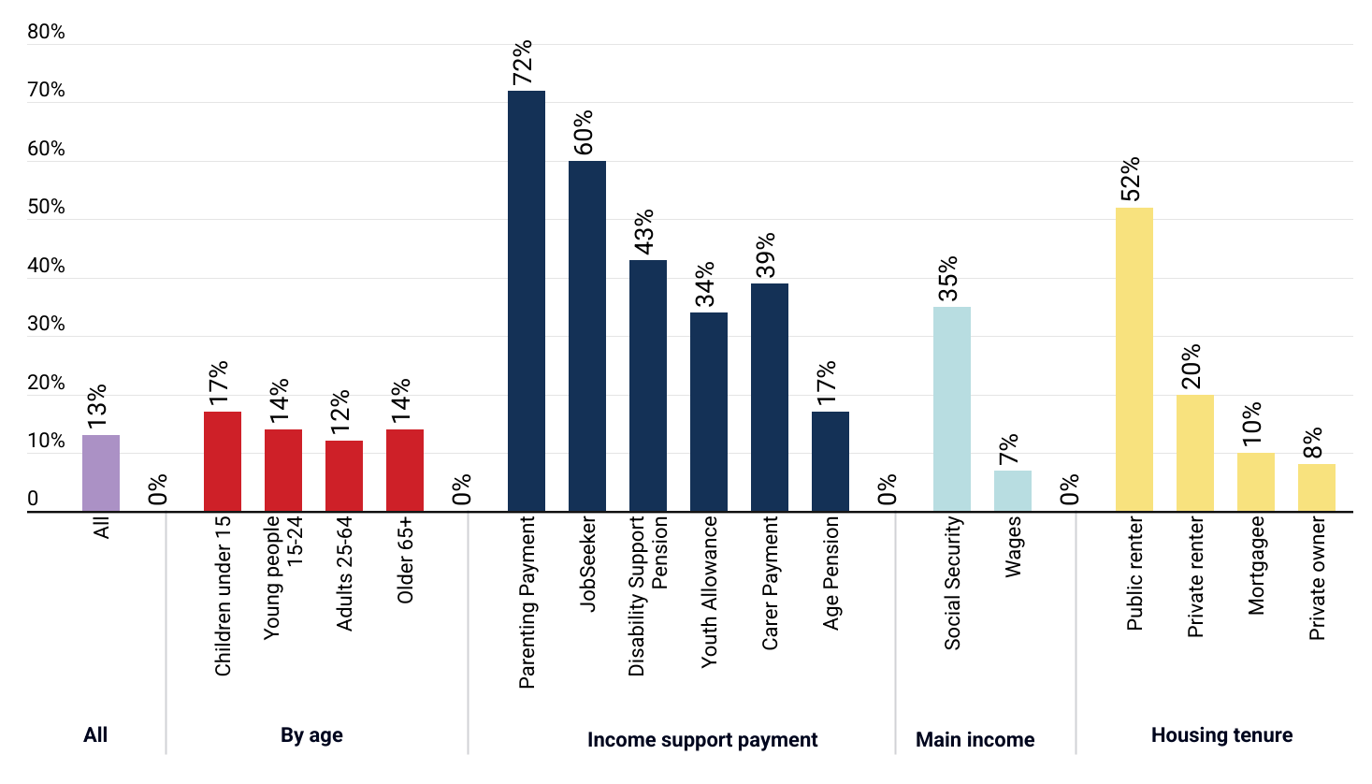
1 in 8 people (13%) live in poverty, but the risk is greater for many
% of people in poverty (2019-20)

Slide 7
Many people on income support live below the poverty line, but COVID payments showed Govts can reduce poverty
% of people reliant on income support payments who were in poverty in 2019 and the (temporary) reduction in poverty due to COVID payments

Slide 8
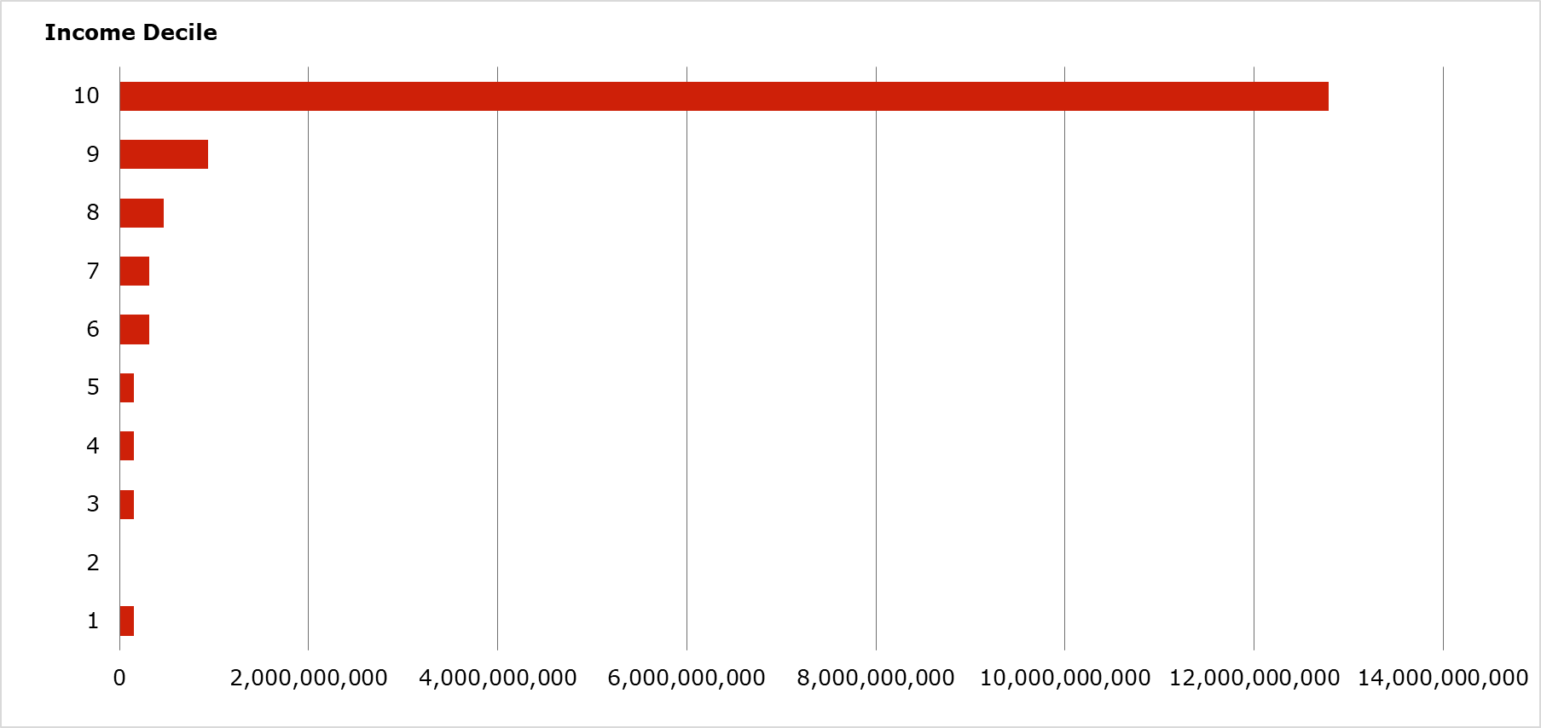
Four fifths of the Capital Gains Tax discount ($13B) goes to the highest 10% of taxpayers
Total value of Capital Gains Tax discount for taxpayers with different incomes ($ in 2021-22)
Source: Treasury (2024), Tax Expenditures and insights statement.

Slide 9
Further information
ACOSS & UNSW Sydney (2023), Inequality in Australia – Overview.
https://povertyandinequality.acoss.org.au/wp-content/uploads/2023/10/Inequality-in-Australia-2023_Overview_screen3.pdf
ACOSS & UNSW Sydney (2024), Inequality in Australia – Who is affected and how?
https://povertyandinequality.acoss.org.au/wp-content/uploads/2024/04/Inequality-Report-2024_who-is-affected-and-how.pdf
ACOSS & UNSW Sydney (2022), Poverty in Australia - A snapshot.
https://povertyandinequality.acoss.org.au/a-snapshot-of-poverty-in-australia-2022/
ACOSS & UNSW Sydney (2023), Poverty in Australia - Who is affected?
https://povertyandinequality.acoss.org.au/poverty-in-australia-2023-who-is-affected/

